Slide 1
Functional vs Non Functional Requirements

Slide 2
Functional vs Non Functional Requirements
Requirements analysis is very critical process that enables the success of a system or software project to be assessed. Requirements are generally split into two types: Functional and Non-functional requirements.
Functional Requirements: These are the requirements that the end user specifically demands as basic facilities that the system should offer. All these functionalities need to be necessarily incorporated into the system as a part of the contract. These are represented or stated in the form of input to be given to the system, the operation performed and the output expected. They are basically the requirements stated by the user which one can see directly in the final product, unlike the non-functional requirements.

Slide 3
Functional vs Non Functional Requirements
Non-functional requirements: These are basically the quality constraints that the system must satisfy according to the project contract. The priority or extent to which these factors are implemented varies from one project to other. They are also called non-behavioral requirements. They basically deal with issues like:
Portability
Security
Maintainability
Reliability
Scalability
Performance
Reusability
Flexibility

Slide 4
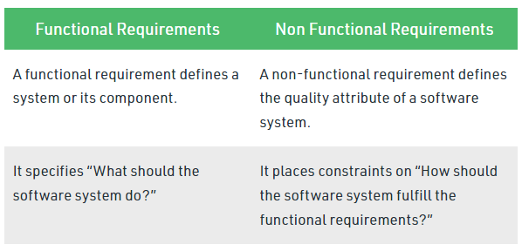
Functional vs Non Functional Requirements
Following are the differences between Functional and Non Functional Requirements

Slide 5
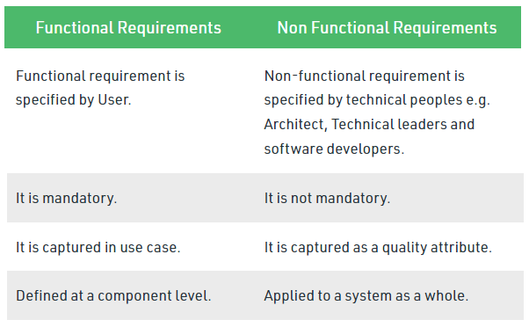
Functional vs Non Functional Requirements

Slide 6
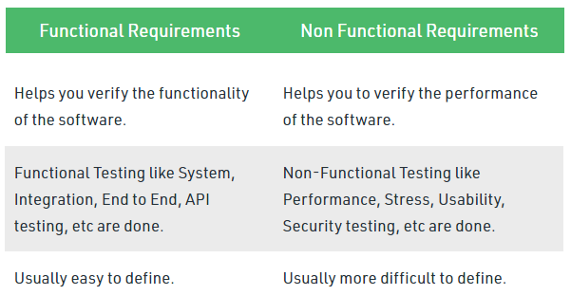
Functional vs Non Functional Requirements

Slide 7
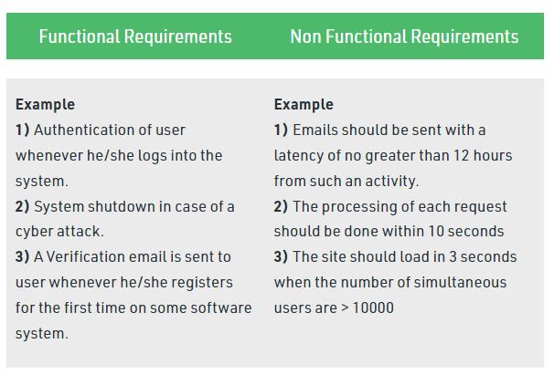
Functional vs Non Functional Requirements

